Slide 1
Graphs
A graph is a data structure representing objects and their interactions
e.g., objects: Facebook users; interaction: Facebook friendship
Formally, objects: vertices; interactions: edges
If there is an edge between vertices u and v (notation: uv), then u and v are neighbours in the graph
Graphs can be:
undirected or directed [direction of interaction]
unweighted or weighted [strength of interaction]
without/with self-loops and parallel edges

Slide 2
Graph Representation
Consider a graph with V vertices numbered 0, 1, …, V − 1
We can represent the edges as an array nbr[] where for each vertex u:
nbr[u] is an array of V bits, nbr[u][v] = 1 iff uv is an edge
Adjacency matrix representation
nbr[u] is a linked list containing all neighbours of u
Adjacency list representation
Question: Which representation is more appropriate for Facebook?

Slide 3
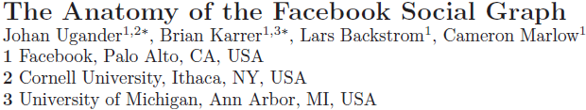
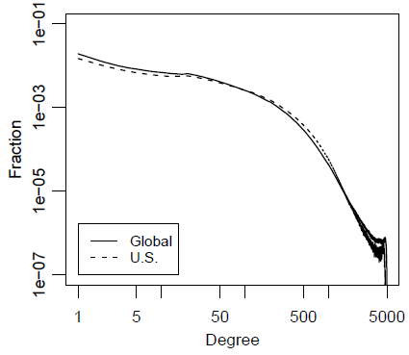
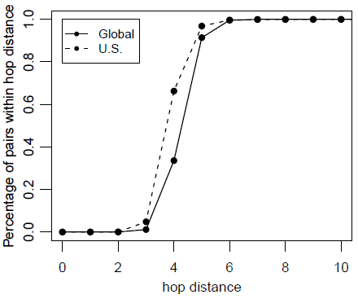
An interesting paper on the FB graph (2011)

Slide 4
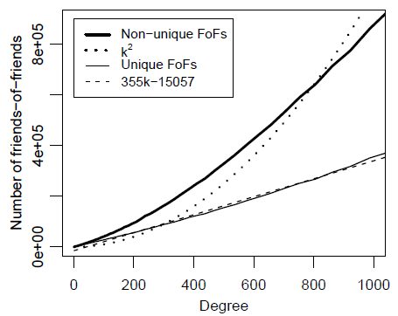
Friends of friends
The number of (unique) vertices within two hops of a given vertex
Measures feasibility of graph search algorithms
If the average number of friends is k, a naïve analysis suggests k² FoFs
A user with 100 friends has
27,500 unique FoFs and
40,300 non-unique FoFs
Much more than 100²!
“Your friends have more
friends than you” (Feld 1991)

Slide 5
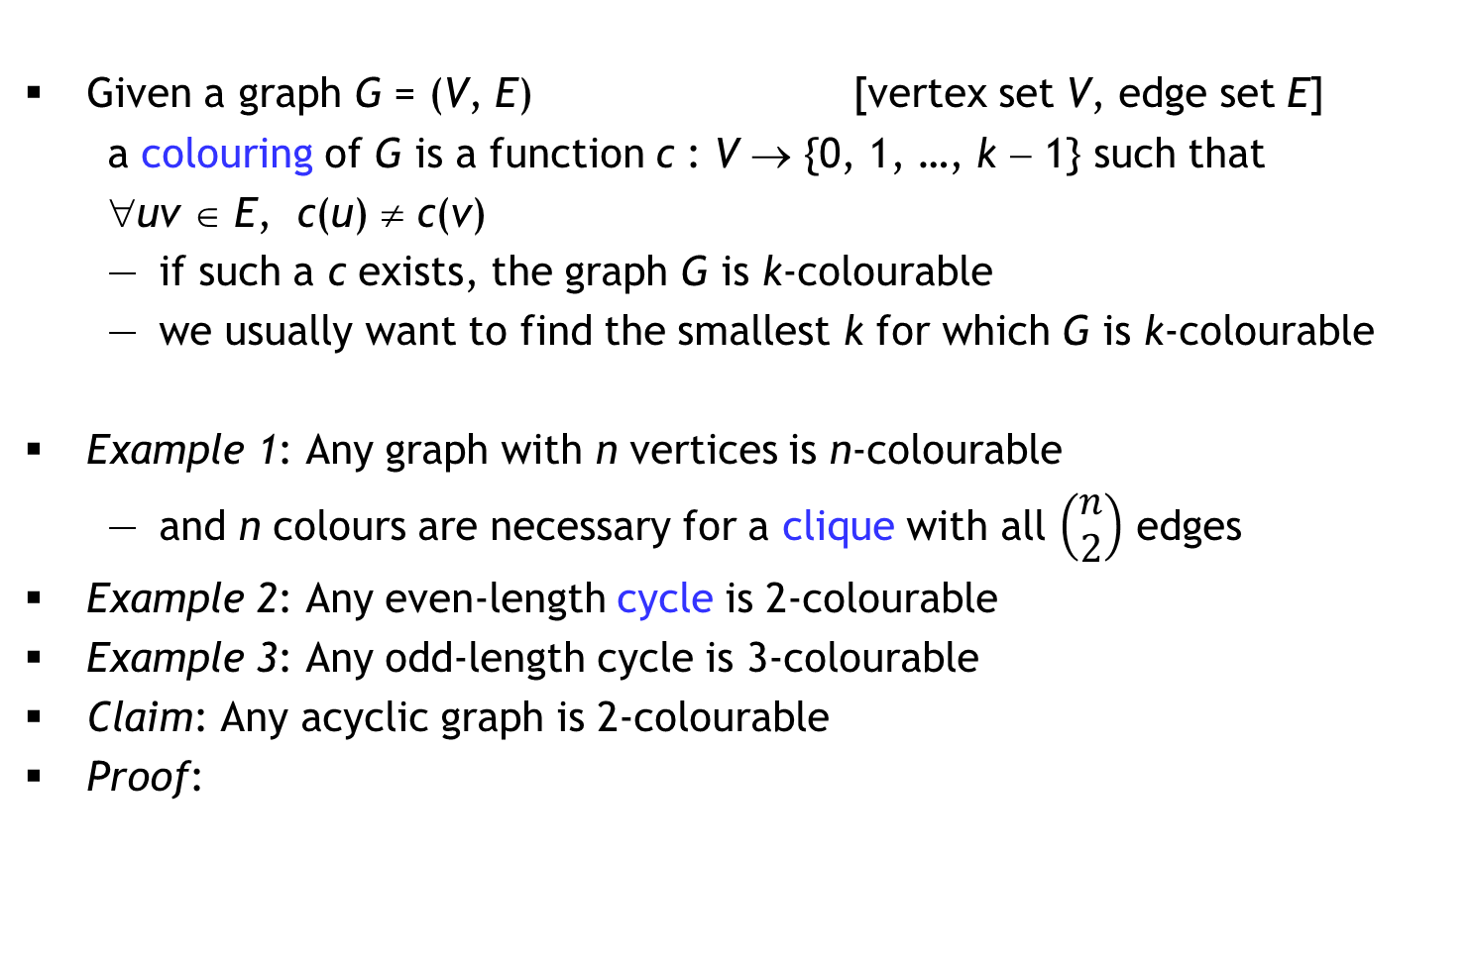
Graph Colouring
Given a graph G = (V, E) [vertex set V, edge set E]
a colouring of G is a function c : V → {0, 1, …, k − 1} such that
∀uv ∈ E, c(u) ≠ c(v)
if such a c exists, the graph G is k-colourable
we usually want to find the smallest k for which G is k-colourable
Example 1: Any graph with n vertices is n-colourable
and n colours are necessary for a clique with all $\left(\begin{matrix}n \\ 2\end{matrix}\right)$ edges
Example 2: Any even-length cycle is 2-colourable
Example 3: Any odd-length cycle is 3-colourable
Claim: Any acyclic graph is 2-colourable
Proof:

Slide 6
Your friend claims that…
☺
If the max. vertex degree in a graph G is d, then G is (d+1)-colourable
“Proof”: Suppose the vertices in G are numbered 0, 1, …, n − 1
for(v = 0; v < n; v++)
c[v] = -1; // illegal colour
for(v = 0; v < n; v++)
for(i = 0; i <= d; i++)
available[i] = true;
for all neighbours u of v in G
if(c[u] != -1)
available[c[u]] = false;
for(i = 0; !available[i]; i++)
/* nothing */;
c[v] = i;
Running time?
Adj. matrix | Adj. list
O(n²)
O(nd)
Number of colours
used depends on
vertex numbering
0
0
1
3
1
2
3
4
2
4
5
5

Slide 7
Adapted from a former Facebook puzzle
“Liar, Liar”
You have just joined an internet forum, and you notice that existing forum members either always lie, or always tell the truth.
You want to split the members into two groups (liars and truth-tellers), so you ask each forum member for a list of liars.
Assume that everyone else has perfect knowledge about others but is busy, so each person will respond with only a partial list of people that they accuse of being liars. Of course these lists shouldn’t be taken at face value because of all the lying going on.
Describe an algorithm that uses these lists to either solve the problem, or determines that it cannot be solved.

Slide 8
Graph Traversal
Consider a bag data structure that supports add and remove operations in O(1) time
traverse(G, s)
for each v in G
visited[v] = false;
bag = {};
visited[s] = true;
bag.add(s);
while(bag != {})
v = bag.remove();
for each neighbour u of v
if(!visited[u])
visited[u] = true;
bag.add(u);
Bag = Queue ⇒ traverse = Breadth First Search (BFS)
Suppose G has n vertices
and m edges
Observation 1: A vertex
is added/removed at most
once from the bag
So, O(n²) with adj. matrix
Observation 2: Sum of all
vertex degrees is 2m
So, O(n + m) with adj. list
O(n)
iterations

Slide 9
Applications of BFS
Determine whether a graph is connected/identify the components
Find a shortest path between two vertices u and v (if one exists)
also works for directed graphs
Determine if a graph contains a cycle
Determine if a graph is 2-colourable (i.e., bipartite)
is2colourable(G)
compute BFS level array;
for each vertex v in G
c[v] = (level[v] % 2);
for each edge uv in G
if(c[u] == c[v]) return false;
return true;
is3colourable(G)
??
$1,000,000

Slide 10
Weighted graphs
Consider a weighted, directed graph where each edge (u, v) has a real-valued weight w(u, v)
Can also define a weighted undirected graph, where w(u, v) = w(v, u)
Single-Source Shortest Path (SSSP): Given a particular vertex s, determine the shortest distance d[v] from s to v for every vertex v
Here, distance = sum of edge weights along a walk from s to v
All-Pairs Shortest Path (APSP): Determine the shortest distance d[u, v] between any two vertices u and v
Note: Negative edge weights can be a problem!

Slide 11
Generic SSSP
SSSP(G, s)
for each v in G
d[v] = ∞;
parent[v] = -1;
d[s] = 0;
bag = {s};
while bag != {}
u = bag.remove();
for each neighbour v of u
if(d[v] > d[u] + w(u, v))
d[v] = d[u] + w(u, v);
parent[v] = u;
bag.add(v);
If weights are positive, each vertex is added/removed once from bag
s
u
v
If SSSPs exist, this
algorithm will find them
Running time depends on
“bag” data structure
If “bag” is priority queue
with priority(v) = d(v), we
have Dijkstra’s algorithm

Slide 12
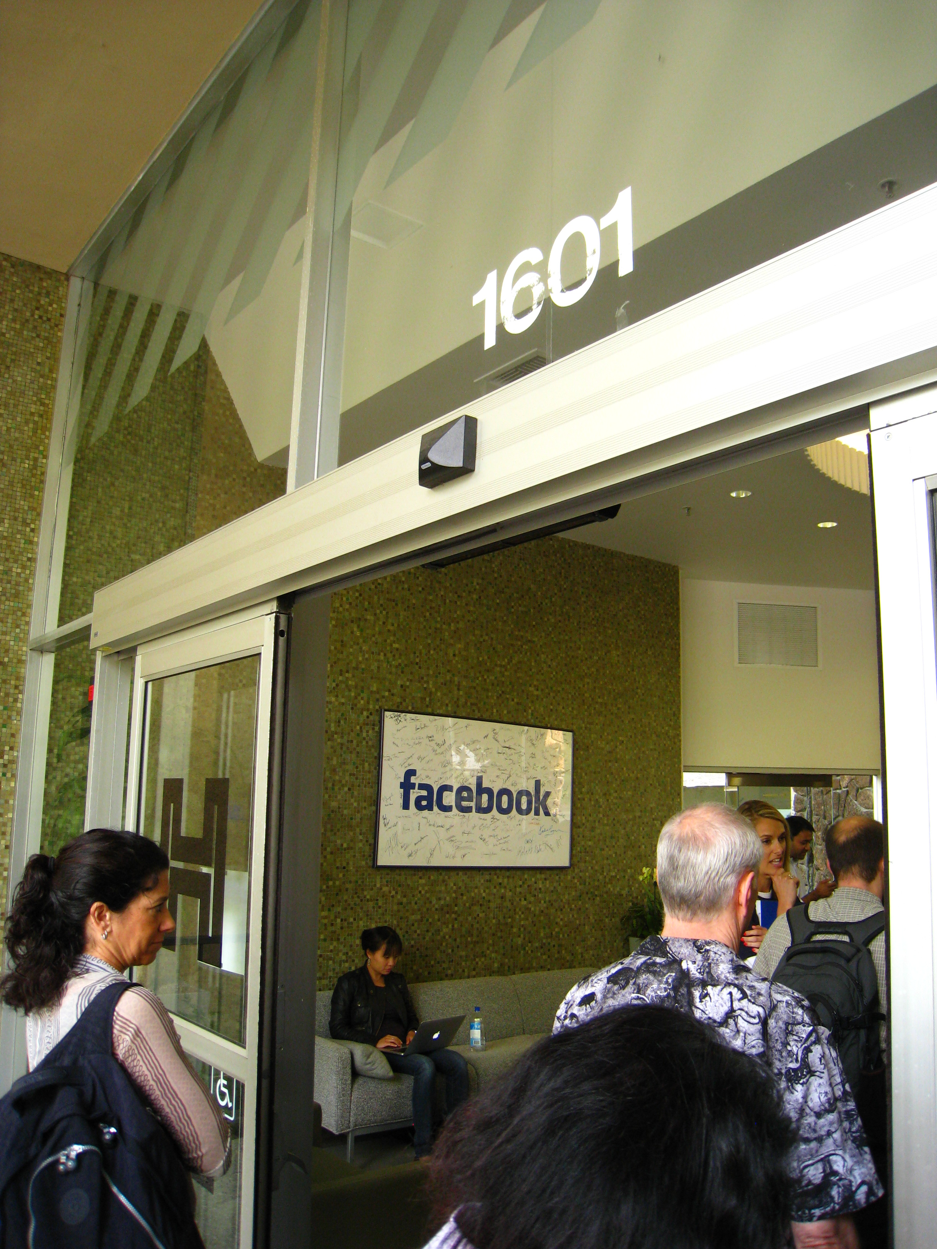

Priority Queue recap
Implementation using a minheap:
O(log n) for insert, delete minimum, update
Implementation using a Fibonacci heap:
O(log n) amortized time for delete minimum
O(1) amortized time for insert and update
Dijkstra’s algorithm on a graph with n vertices
and m edges performs:
n inserts
n delete mins
m updates
Robert Tarjan

Slide 13
Minimum Spanning Tree (MST)
A tree is a connected, acyclic graph
A subgraph of G = (V, E) is H = (V’, E’) where V’ ⊆ V and E’ ⊆ E
a spanning tree of G is a subgraph T = (V, E’) such that T is a tree
only exists if G is connected
Useful fact: |E’| = |V| − 1
Consider a weighted, undirected, connected graph G = (V, E) where each edge uv has a real-valued weight w(uv)
Assume that all edge-weights are distinct
We want to find a spanning tree of G whose sum of edge weights is minimized
Generic MST algorithm: Maintain a forest F whose edges form an MST for each connected component (initially, no edges), and repeatedly add edges

Slide 14
Growing the forest F by adding edges
Let e be the lightest edge with exactly one endpoint in a component of F
the other endpoint is in a different component of F, or not in F
Suppose there is an MST T which does not include edge e = uv
Then there is a path in T from u to v
This path has an edge e’ with exactly one endpoint in this component
So w(e) < w(e’)
Consider the spanning tree T − e’ + e [why is it a tree?]
Now w(T − e’ + e) = w(T) − w(e’) + w(e)
< w(T), a contradiction [why?]
Initialize F = ({u}, ∅) [Prim], or F = (V, ∅) [Kruskal]
e
Key Lemma: The edge
e must belong to the MST
e’
Priority Queue
Union Find

